Slide 1
A RISING TIDE:
The 2018
NextGen Public Media Co-op

Slide 2







THANKS TO OUR 2018 SPONSORS

Slide 3
NextGen Public Media Co-op
MORNING SESSIONS
Sponsored by:

Slide 4
Fundraisers Channeling
Fred Rogers
Dr. Sophie Penney, Penn State University

Slide 5
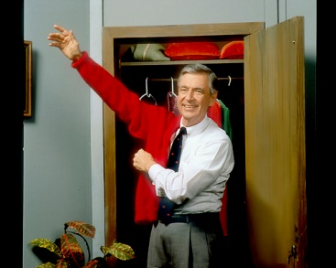

Fundraisers Channeling
Fred Rogers©

Slide 6
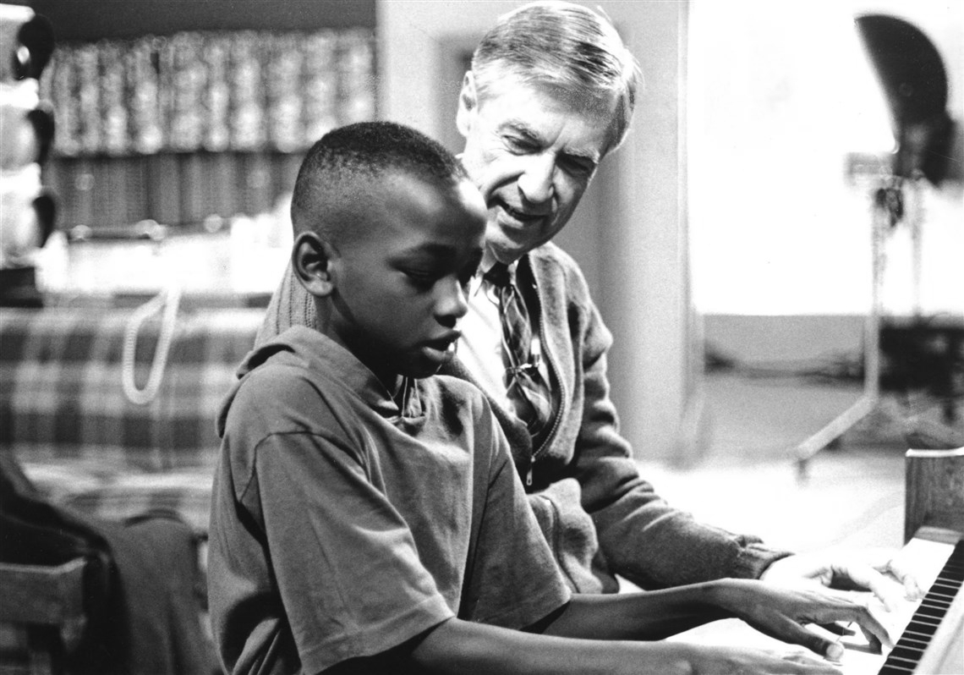
Won’t You Be My Neighbor?
Notes:
There has been a revival of interest in Fred Rogers, a U.S. A. television icon. Fred’s life and work have been or will be spoken about in a new biography, two documentaries and a feature film starring another icon, Tom Hanks.

Slide 7
What to you feel when you hear?
Invited?
Welcome?
Warm?
Cared About?
Notes:
So why might a fundraiser want to channel Fred Rogers? He emulates qualities that may of the best already possess and characteristics, as well as skills, which we might all strive to hone.

Slide 8
Fundraisers Channeling Fred Rogers?
Curiosity
Listening
Learning
Loving
Resilience

Slide 9


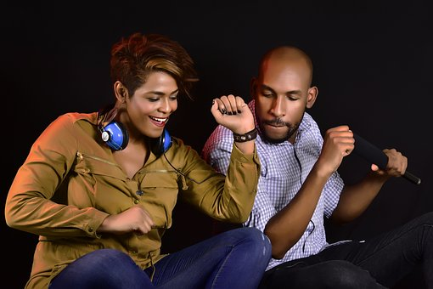
Curiosity About
Notes:
People, places and things

Slide 10
What do we want to know?
We want to identify missions,
programs, and projects and
identify donors who
share our passion
for these missions, programs and projects.

Slide 11
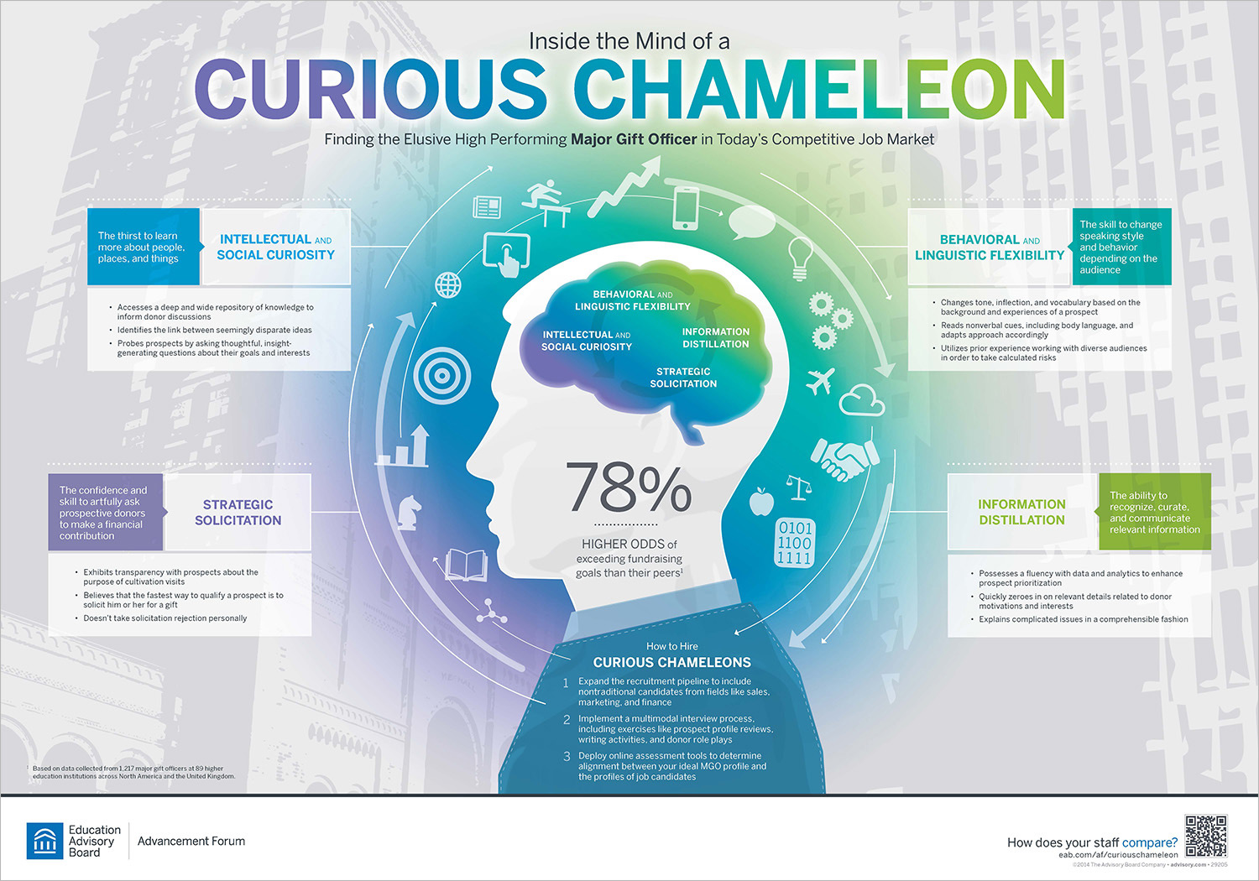

Slide 12
Curious Chameleons Possess
Behavioral and linguistic flexibility
Intellectual and social curiosity
Skill to distill information
Ability to approach the solicitation process in a strategic manner
EAB September 14, 2014

Slide 13
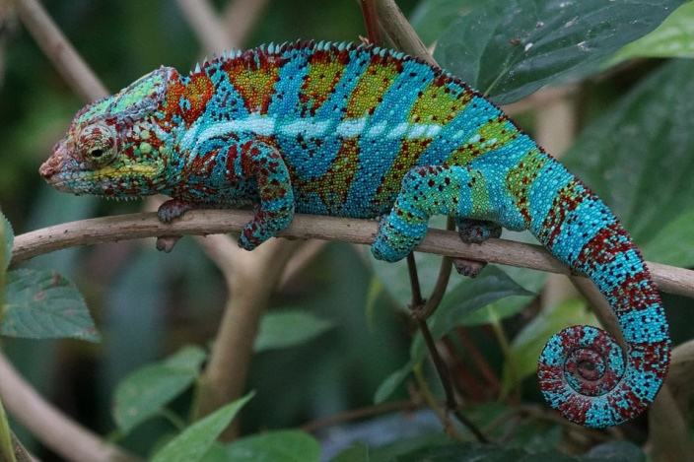
Curious Chameleons
3.8% of EAB survey population
78% higher odds of
exceeding goal
Notes:
EAB surveyed 1,217 major gift officers at 89 colleges and universities in North America and the United Kingdom—

Slide 14
Getting to know Your Neighbor
Pair up and ask just one question
What might you like someone to know about you that you think might not
be obvious when someone meets you?

Slide 15
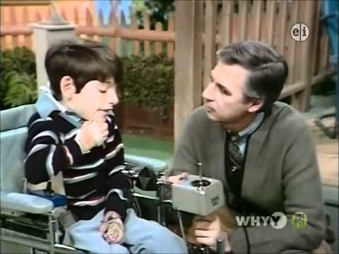
What Fred Said . . .
It’s no secret that I like to get to know people – and not just the outside stuff of their lives.
I like to try to understand the meaning of who people are and what they are saying to me.
The World According to Mr. Rogers: Important Things to Remember, Family Communications Inc., 2003, p. 135.

Slide 16
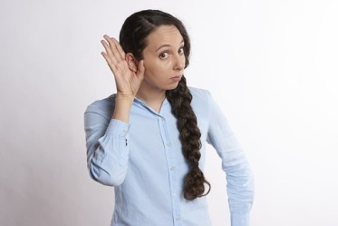
Listening

Slide 17
Put another way
Informing
Who
About What?

Slide 18

Ourselves about donors
What motivates them to give?
Why our organization?
Why now?

Slide 19
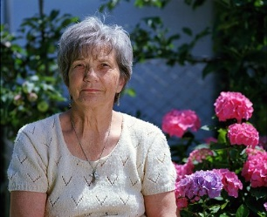
Informing
“’The only thing people see
In me is money.
Wherever I go,
I am the rich person . . .”
A Spirituality of Fundraising
Henri J.M. Nouwen

Slide 20
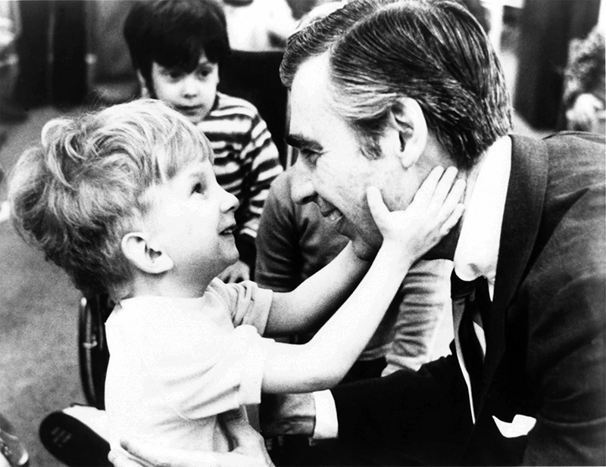
Be Interested

Slide 21
Why?
“She is not your donor
You are one of her charities!”
Tom Ahern
VFRI

Slide 22
It’s You I Like
It's you I like,
It's not the things you wear,
It's not the way you do your hair--
But it's you I like.
The way you are right now,
The way down deep inside you--
Not the things that hide you,
Not your toys--
They're just beside you.
Notes:
https://video.search.yahoo.com/search/video?fr=mcafee&p=Fred+Rogers+it%27s+you+I+like#id=2&vid=5d861808607c05a1cae4075bf24feac1&action=click

Slide 23
It’s You I Like
But it's you I like--
Every part of you,
Your skin, your eyes, your feelings
Whether old or new.
I hope that you'll remember
Even when you're feeling blue
That it's you I like,
It's you yourself,
It's you, it's you I like.
It's You I Like
By Fred M. Rogers
© 1970

Slide 24

What Fred Said . . .
Listening is where love begins: listening to ourselves and then to our neighbors.
The World According to Mr. Rogers: Important Things to Remember, Family Communications Inc., 2003, p. 93.

Slide 25

Learning

Slide 26
It’s Your Opportunity!
To inform the donor
  What?
  When
  Why?
  How?

Slide 27
How?
Write down one to three objectives for each donor.
  Help Betty become aware of three ways in which aquatic therapy differs from land-based exercise.
  Enable Betty to experience the joy felt by aquatic therapy participant.
2. Identify resource materials and persons to that can help you meet those objectives.

Slide 28
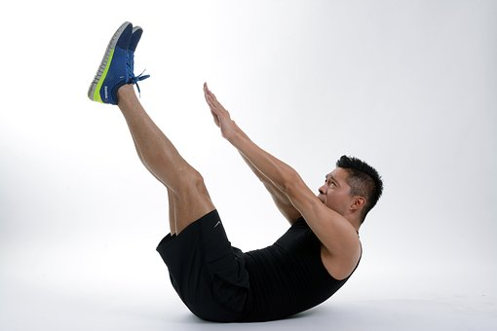
Exercise

Slide 29
What Fred Said
“I hope you are proud of yourself for the times you’ve said ‘yes,’ when all it meant was extra work for you and was seemingly helpful only to somebody else.”
The World According to Mr. Rogers:
Important Things to Remember,
Family Communications, p 113.

Slide 30

Facing Fear . . . of Asking

Slide 31
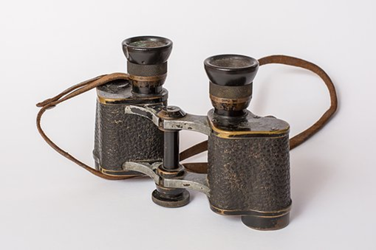

Reframe “the ask”

Slide 32
Put another way
Maybe we fundraisers should stop saying:
"Ask for gift..." And instead
talk about
"inviting someone to give.“
Simone Joyaux
Twitter, October 2018

Slide 33
You are . . .
Asking on behalf of the nonprofit, not yourself.
Inviting donor to invest in changing and saving
lives.
3. Providing the potential for bringing great joy
to that donor.

Slide 34
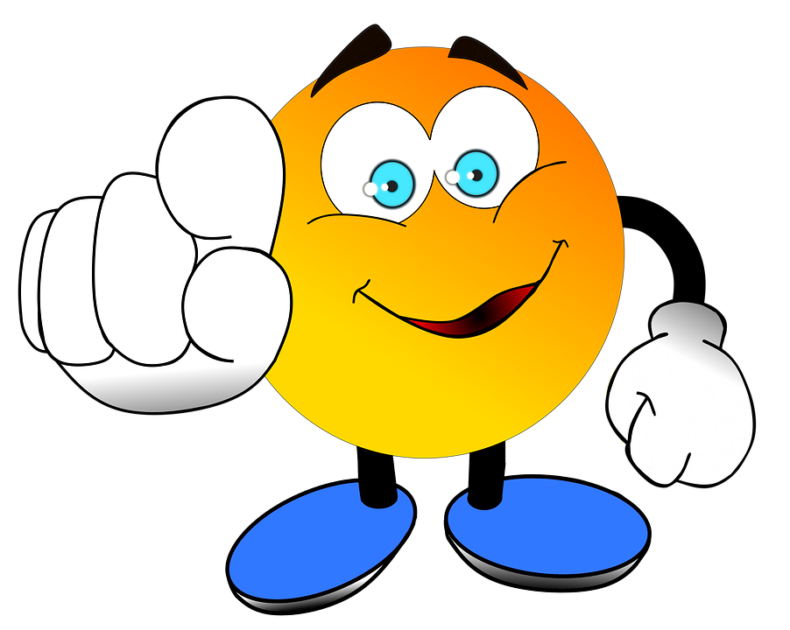
Quickly Invite Someone to Give

Slide 35
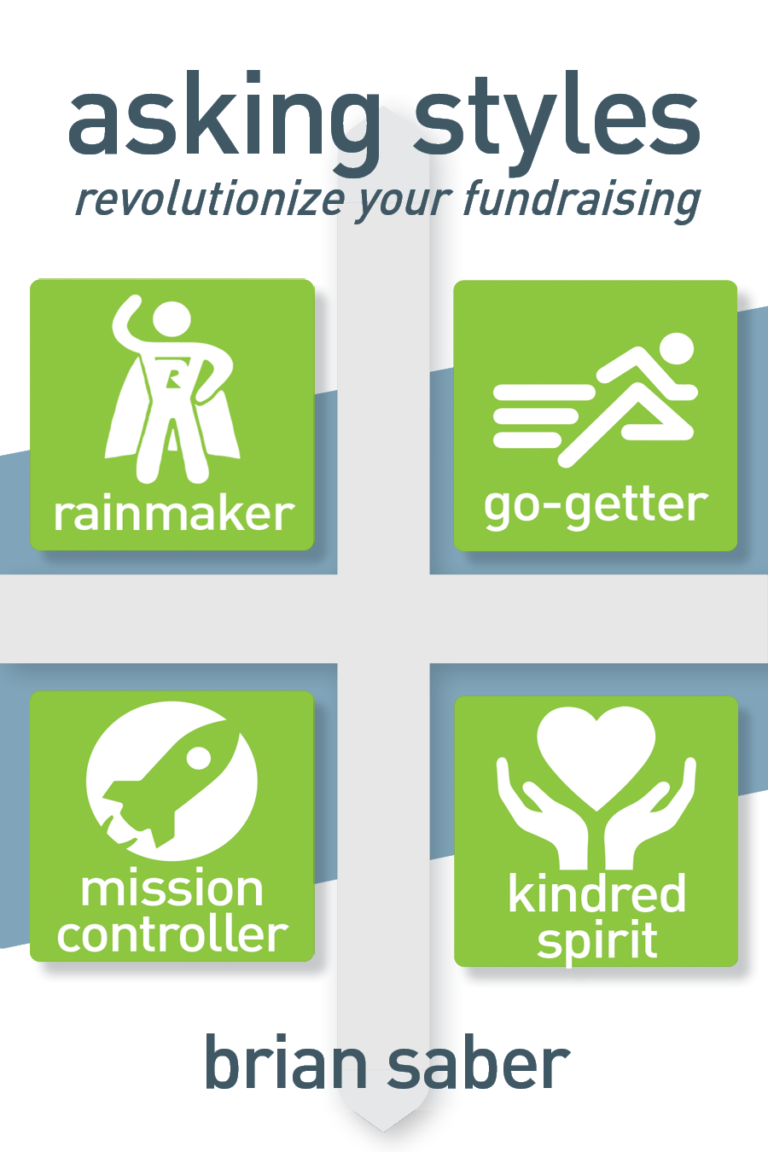
Need More Information?

Slide 36
What Fred Said
“Imagining something may be the first step in making it happen, but it takes the real time and real efforts of real people to learn things, turn thoughts into deeds or turn visions into inventions.”
T
he World According to Mr. Rogers:
Important Things to Remember, Family Communications
p. 99

Slide 37

Love

Slide 38
What?
“You might not realize it ... but you actually DO have something to give back to the donor that's of great, probably inestimable, - value for many of them ... Give them ...
Your love.
Your respect.
Your admiration.”
Tom Ahern

Slide 39
What Fred Said
“Love is like infinity: You can’t have more or less infinity, and you can’t compare two things to see if they are ‘equally infinite.’ Infinity just is, and that’s the way I think love is too.”
The World According to Mr. Rogers:
Important Things to Remember,
Family Communications Inc., 2003, p. 91.

Slide 40

Writing an (Impact) Love Letter

Slide 41

No Easy Button

Slide 42
Fred Said . . .
“For any of us mutually caring relationships will also include some measure of unkindness and impatience, intolerance, pessimism, envy, self-doubt and disappointment.”
World According to Mr. Rogers
p. 78.

Slide 43

“Life is a series of natural and spontaneous changes. Don't resist them; that only creates sorrow. Let reality be reality. Let things flow naturally forward in whatever way they like.”
Lao Tzu

Slide 44
Quit?
Quitters Never Win: Who Says?
Lost Opportunity Cost
Sunk Cost

Slide 45
Learn how to be
Resilient!
How Resilience Works, Dianne Coutu
Harvard Business Review
May 2002
Notes:
Three Tips: 1. Face reality 2. Find Meaning 3. Make do with what you have

Slide 46
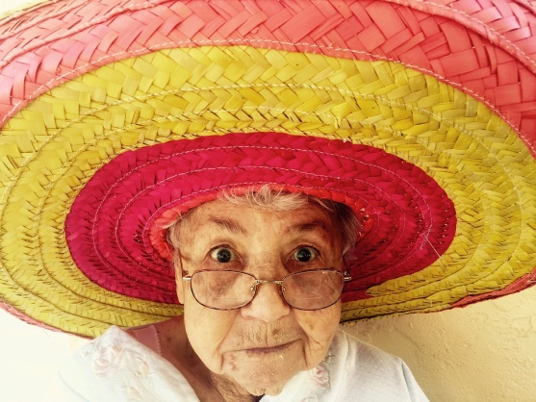
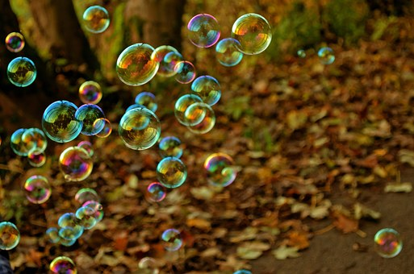
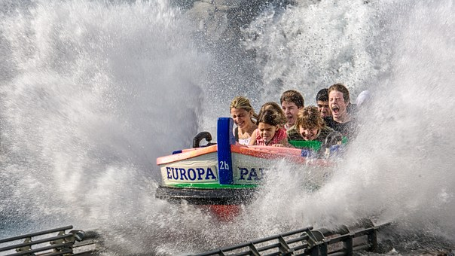
Have FUN!

Slide 47
What Fred Said: You Are Special
You are my friend
You're special to me.
There's only one in this wonderful world
You are special.
You Are Special
Fred Rogers
©1967

Slide 48
Sophie W. Penney, Ph.D.
President
sophie@i5fundraising.com
Newsletter Sign Up
All rights reserved. No part of this publication may be reproduced, distributed, or transmitted in any form or by any means, including photocopying, recording, or other electronic or mechanical methods, without the prior written permission of the author.

Slide 49
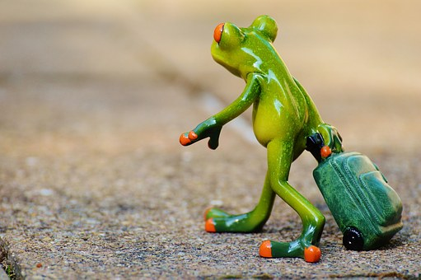

Slide 50
ENERGY BREAK

Slide 51
Co-op Innovation Series:
Part I
John Perrell, Friends of The Smithsonian Institution
Dr. Sophie Penney, Penn State University

Slide 52
Target Analytics
New Offerings
George Whelan, Account Executive
Target Analytics
October 2018

Slide 53
Discussion Overview
Introductions
Target Analytics Overview
Email Optimization
Direct Marketing Insights Bundle

Slide 54
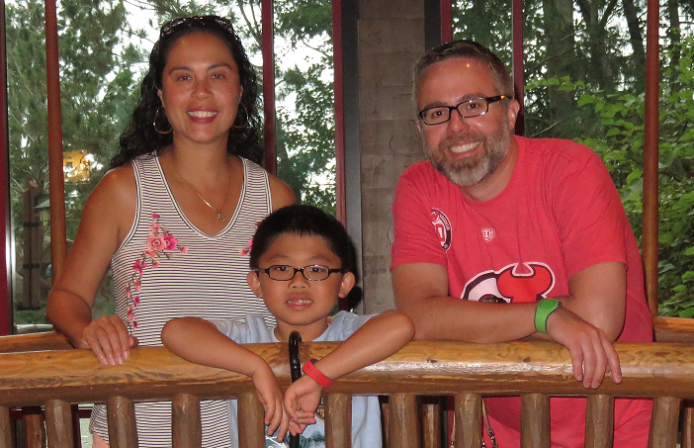
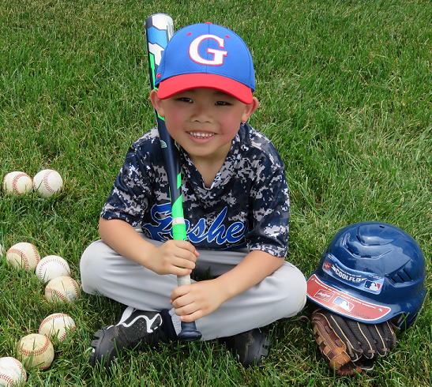
Hello! I’m George!
At Blackbaud 7 years+
Hometown New York, NY
  Married father of one rambunctious 8 year old and one equally rowdy 3 year old
  1st generation American of Cuban/Irish descent
  Spent 19 years working at non-profits before joining Target Analytics where I managed both direct response and development programs
  Big baseball (Yankees) and hockey (Devils) fan. Played both high school and collegiate hockey
  George.whelan@blackbaud.com 617-894-2714

Slide 55
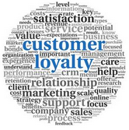
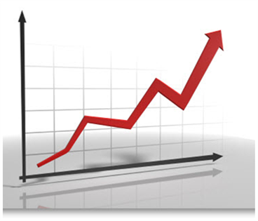
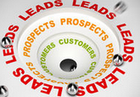
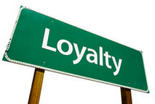

DIRECT MARKETING SERVICES
Loyalty Insights
Channel Indicators
Lapsed Tags 2.0
Conversion Tags
Lapsed Insights
Loyalty Insights score active donors into 7 behavioral groupings to provide a clear understanding of which donors have the strongest affinity to your cause
Channel Indicators provide rankings for Strong, Moderate and Weak usage of Online, Telemarketing and Sustainer Giving.
Lapsed TAGS Next Generation will allow for custom campaign modeling, utilizing client campaign inputs, license and proprietary data sources, and regression analysis.
Conversion Tags help you stratify your warm prospect pool (e.g. activists, event attendees, patients, etc.) and rank them according to their likelihood of giving a donation.
Lapsed Loyalty Insights score lapsed donors into 6 behavioral groupings to provide a clear understanding of your donors’ giving history prior to lapsing.

Slide 56
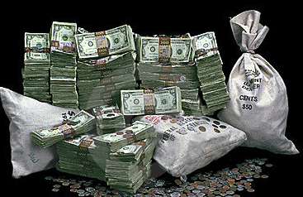
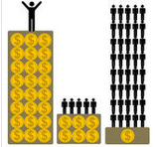
WEALTH SCREENING & PREDICTIVE MODELING
Planned Giving Models rank your constituent file based on their likelihood of making a planned gift (e.g. charitable bequest, charitable remainder trust or charitable gift annuity).
Target Gift Range Models
Major Giving Models
Planned Giving Models
Target Gift Range Models rank your constituent file based on their likelihood of making an annual gift to you within a certain dollar range, from below $50 to $50,000.
Principal Giving Models
Wealth Screening
Principal Giving Models look for the extraordinary prospects in your file, capable of making transformative gifts of $50,000 up to more than $1 million.
Major Giving Models rank your constituent file based on their likelihood of making a major gift.
WealthPoint is a screening tool that uncovers wealth, career & philanthropic connections on individuals most likely to be major gift prospects.

Slide 57
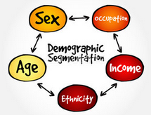



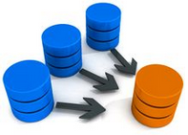
DATA SERVICES OVERVIEW
Data Enrichment
Data Health ScoreCard
Email Delivery Opt.
Persistent Key
Merge/Purge
Data Enrichment Services include everything from NCOA and address & phone appends to demographic, consumer interests & lifestyle appends
The Data Health Scorecard evaluates a client’s data health across 7 different categories, assigns an overall grade and recommends how to fix identified problems.
Email Delivery Optimization introduces best-practices of your email file with our expertise, maximizing results on every email you send.
Unique Individual Keys applied to all donors with PII. Keys link individuals & households within and across files.
Merge Purge includes address hygiene, suppression, removal of duplicate records, post merge modeling, and reporting. List Fulfillment Services available as well.

Slide 58



Email Delivery
Optimization

Slide 59
Email List Optimization Addresses….
Email is a critical channel for both communication and fundraising, driving the majority of digital giving. With email volume increasing dramatically, mailbox provider like Gmail and Yahoo have used complex and ever-changing algorithms to prevent unwanted (SPAM) messages from getting through to inboxes
Net of these changes: less emails are getting through to inboxes, adversely impacting giving. Bad list quality is costing nonprofits an estimated $24,500 annually.
Getting emails delivered (and minimizing revenue loss) involves active and diligent list grooming…a time-consuming activity many nonprofits don’t have resources to do. But you can’t afford NOT to.
Notes:
What is bad email list hygiene costing you?
18% of nonprofit fundraising emails going to SPAM folders
36% of #GivingTuesday emails going to SPAM folders
Average nonprofit housefile leaving $24,500 per year on the table

Slide 60
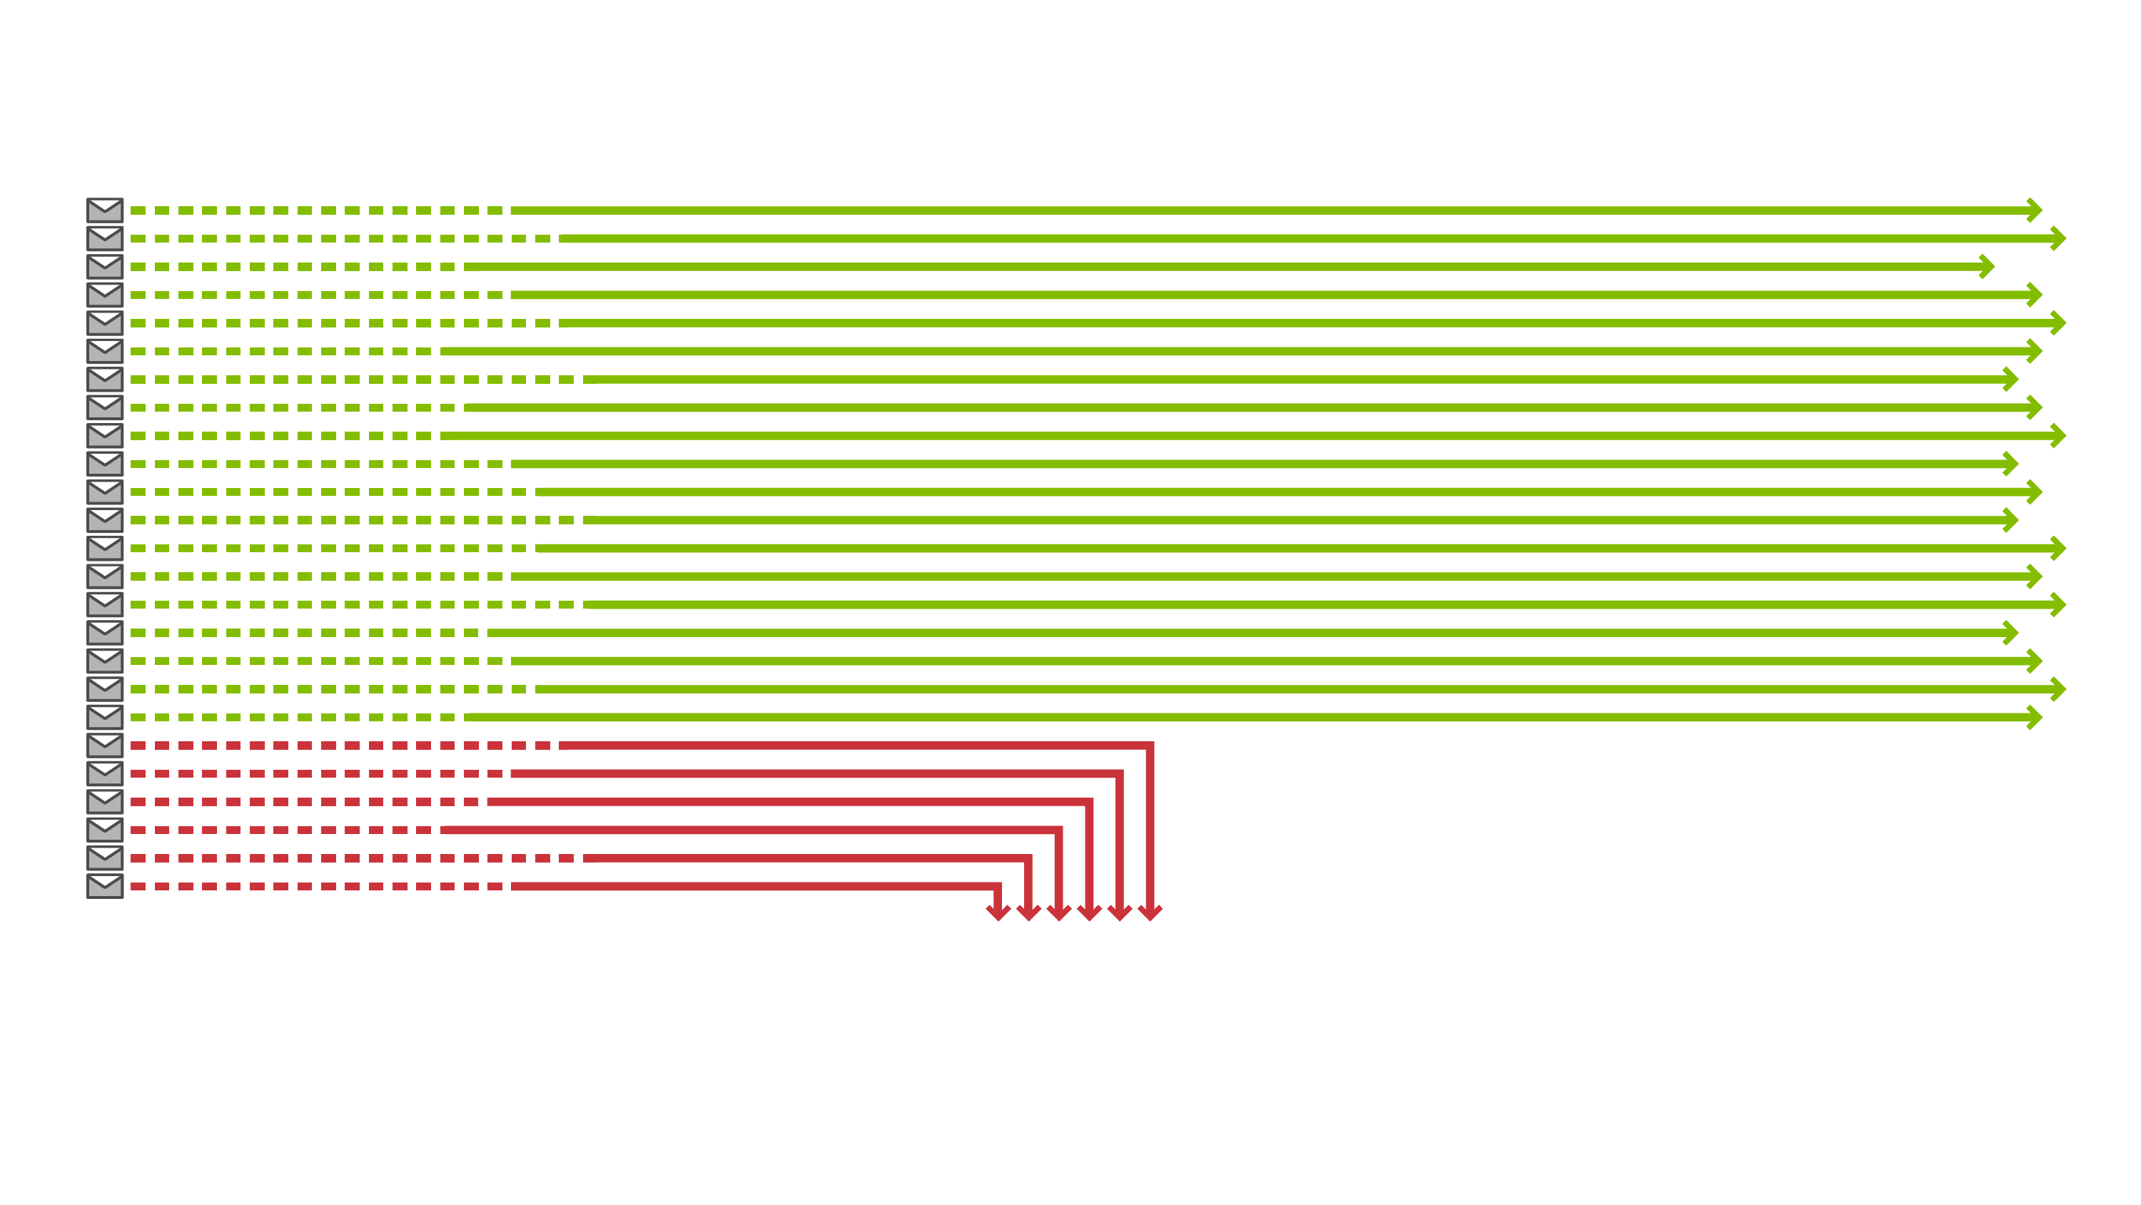
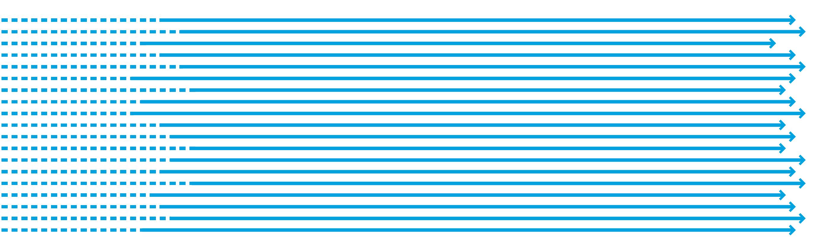


It’s Harder than ever to reach the inbox
76%
Source: Return Path 2016
Notes:
Harder than ever to reach the inbox. Return Path states that Not only are we seeing a record low Inbox Placement Rate of 76%, this number has dropped quarter over quarter for the last year – indicating a key trend in deliverability.
[Statement: On average, 24% of promotional emails land in spam or get blocked]
On average, 24% of promotional emails were filtered to spam or blocked in according to our 2016 Deliverability Benchmark report. In a potentially concerning trend, we found that deliverability rates declined every quarter over the past year. Part of this decline is due to engagement spam filtering. To find the emails that people want, email providers train their filters to look for signals from subscribers—things like whether they are opening the message, replying to it, or deleting it without ever opening it or marking it as spam. Without the right data or solution, engagement filtering makes it more difficult for email marketers to resolve deliverability issues.
[BUILDS AUTOMATICALLY NO CLICKS NEEDED]

Slide 61
Email List Optimization Helps Get Your Message Through
Blackbaud can help automate best-practice management of your email file with Blackbaud Target Analytics and our expertise, maximizing results on every email you send.
Subscription Includes:
  Email hygiene data append, run 2x annually, from TA that identifies the following issues that affect email deliverability:
  Spam Traps/ “honey pots” (i.e. flag trap email addresses on your file)
  Screamers (i.e. check your list for frequent Spam complainers)
  ISP handshake (i.e. is each address valid & accepting mail?)

Slide 62
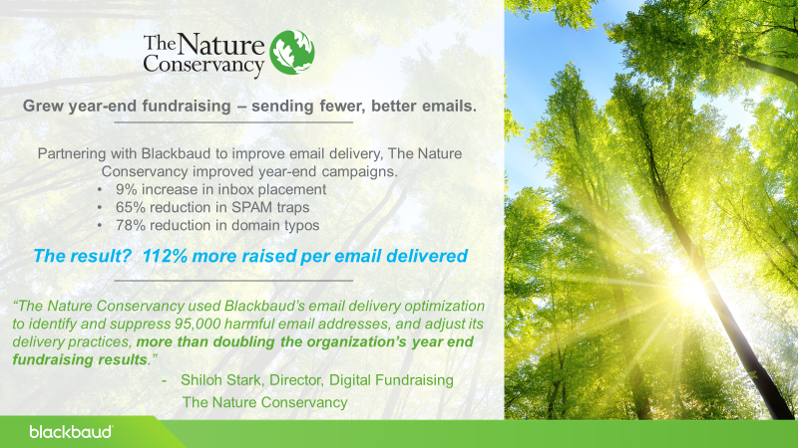

Slide 63
Direct Marketing Insights Bundle

Slide 64






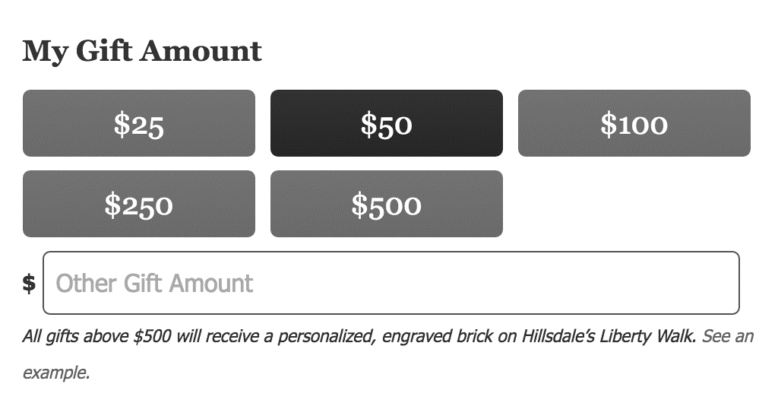


DIRECT MARKETING INSIGHTS
Philanthropic Scores
Channel Scores
Specialty Scores
Philanthropic Score
Direct Marketing Score
Sustainer Score
Donor Persona
Phone Score
#GivingTuesday Score
Direct Mail Gift Array
Online Score
End of Year Giving Score

Slide 65





Philanthropic Score
We use past giving behavior combined with Blackbaud’s proprietary data to score each constituent based on their likelihood to be philanthropic.
Target individuals that are LIKELY TO GIVE, which can help save costs for your direct response programs and avoid spanning individuals who are not likely to donate.

Slide 66


Sustainer Score
We use past giving behavior combined with Blackbaud’s proprietary data to score each constituent based on their likelihood to participate in a sustainer program.
The annual Blackbaud Luminate report revealed that sustainer giving has grown more than 20% over the past year and now represents 8.4% of total giving. It is a program that will become an increasingly important driver of fundraising growth.

Slide 67




Channel Scores
Channels scores use donor behavior across billions of transactions to predict the channels through which a constituent is likely to respond.
Campaigns that engage individuals across multiple channels have a 24% higher ROI. Knowing which combination of channels is optimal for each person will help drive engagement.

Slide 68

Gift Array
Based on each constituent’s giving history, demographics, and wealth profile, the gift array proposes the optimal amount to ask during the next campaign.
Your Donation:
$25
$50
$100
Psychology tells us that people more often choose the middle offer. The middle gift amount served up in the gift array is the amount that a constituent is most likely to give.

Slide 69
THAT’S ALL FOR NOW!
George Whelan
Senior Account Manager
Target Analytics, a Blackbaud Company
617-894-2714
George.Whelan@Blackbaud.com

Slide 70
ENERGY BREAK

Slide 71
Lunch & Service Project Presentation
South Pointe Ballroom

Slide 72
Co-op Innovation Series:
Part II
Marc Supsic, Marketing & Branding Consultant
Kristine Masta, Fundraising Consultant

Slide 73
Peer 2 Peer
Kristine A. Masta
Next Generation Fundraising Coop Meeting

Slide 74
1 in 4 emails from a family member or friend results in a donation
Crowd-fundraising is projected to exceed $20 Billion by 2020
91% of millennials prefer brands associated with a cause*
Average Gift to a Non-Profit is $68
Average Gift on Giving Tuesday is $128
*Cone Communications Millennial Study

Slide 75
Board + Workplace Giving
Capital Campaigns
Give your Birthday, Anniversary,
General Fund
DIY
Project Based
  Specific, tangible,
  over a period of time
Evergreen
Non-restricted
3. Event Based
Restricted or
Non-Restricted
Giving Tuesday
Dance-a-Thon
Virtual 5K Run
Advocacy + Capacity Building
Build Your File
Get Your Creative On
Notes:
Giving Tuesday we are seeing the average gift at $128

Slide 76
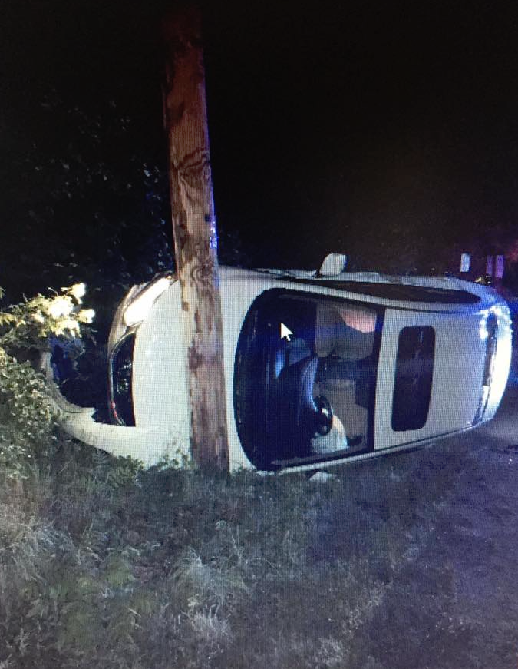
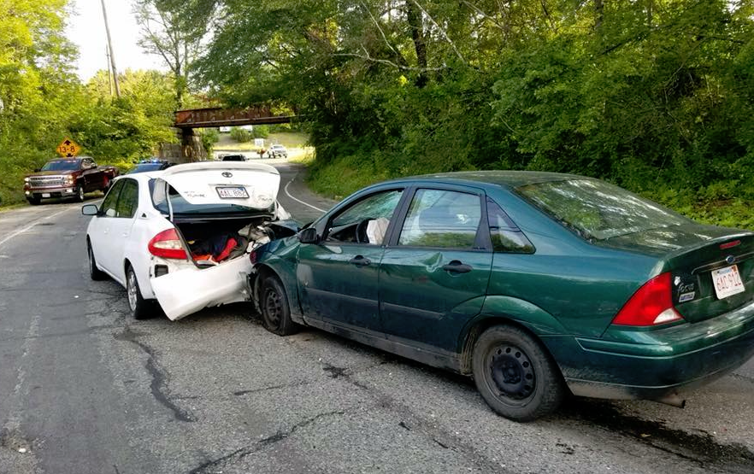
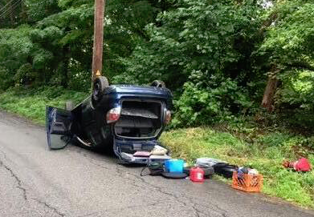
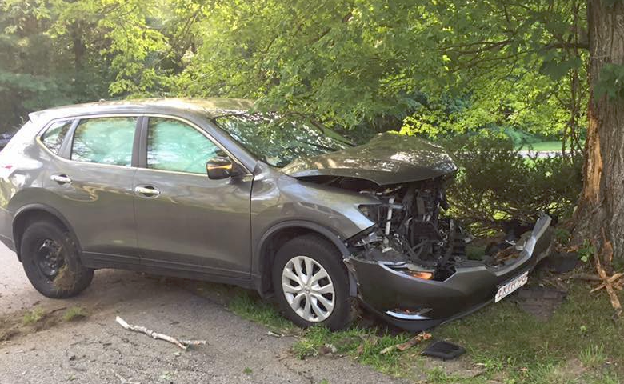
Buckle
Up
Sutton
Darren
For
City Council
It costs the taxpayer $250,000 to $500,000 to purchase and install a traffic signal. Electric bills and routine maintenance amount to about $8,000 a year.
A Single Speed Bump Costs $3,500
A Single Stop Sign or Neighborhood Sign and pole Costs $65 plus Labor

Slide 77
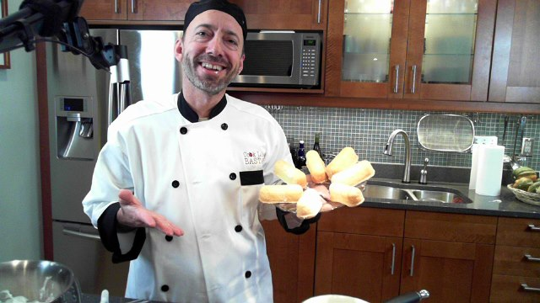
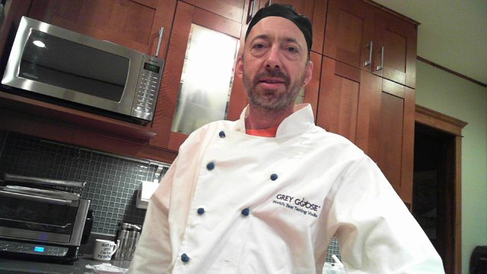
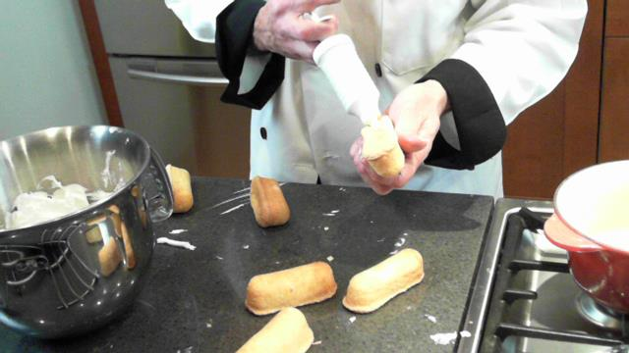
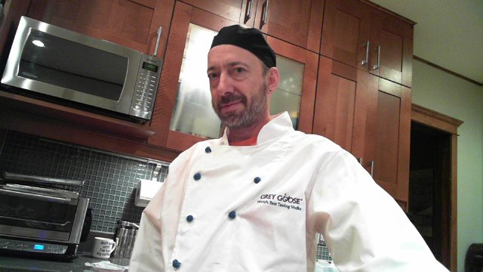
Costs for a You Tube Production can range from $1,200-$50,000, the average is $10,000.
Cook Like a Bastard!

Slide 78
The Power of Video:
Quick Sips and Tasty Tips from a Sommelier
Marc Supsic, DWS

Slide 79
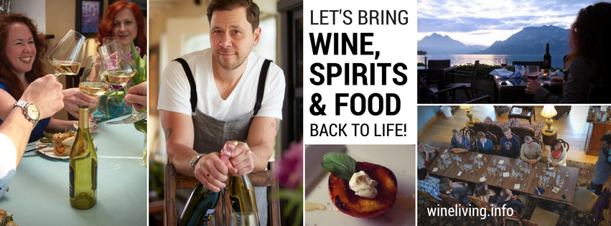
G: Goal
What’s your message?
Why make a video?
“Going viral” is not a realistic goal

Slide 80
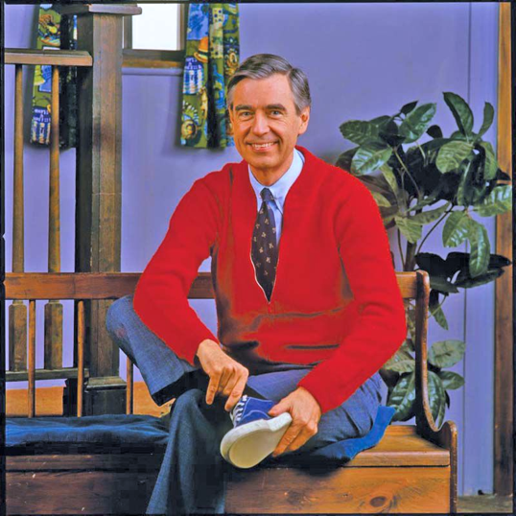
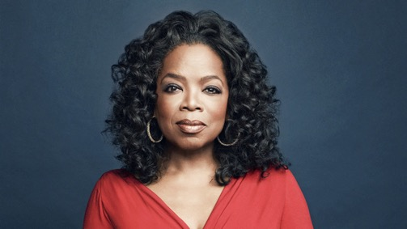
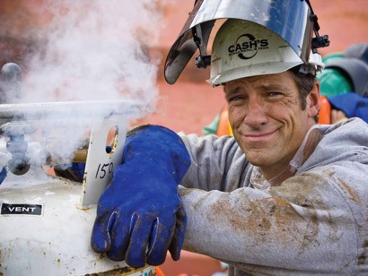
R: Be Real
Be genuine
Find your voice, language
There’s a unique audience for you – your tribe

Slide 81
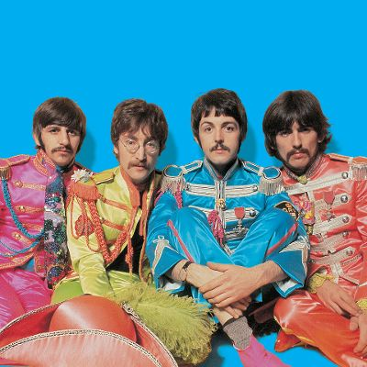
A: Adventure
Tell a story
Entertain people, make it fun
Take creative risks
Arc/distortion of time: Beatles

Slide 82
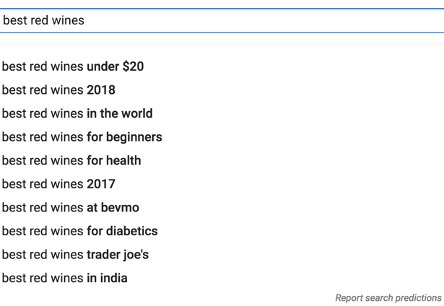
A: Answers
YouTube is owned by Google, a search engine
Solve a popular problem
Be generous: give information, tips, resources

Slide 83
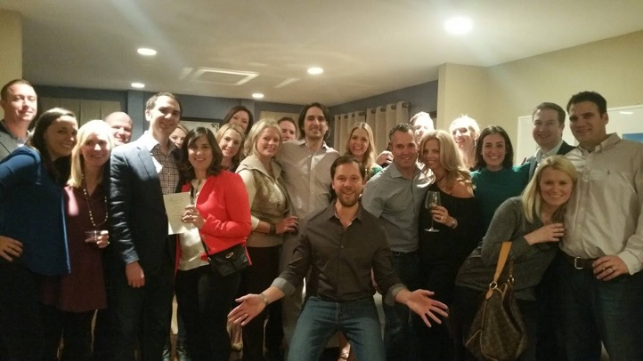
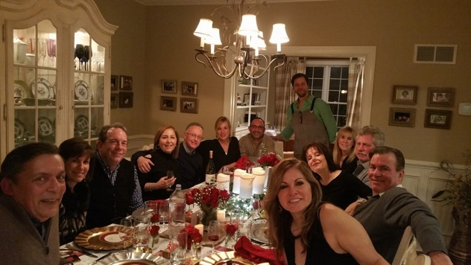
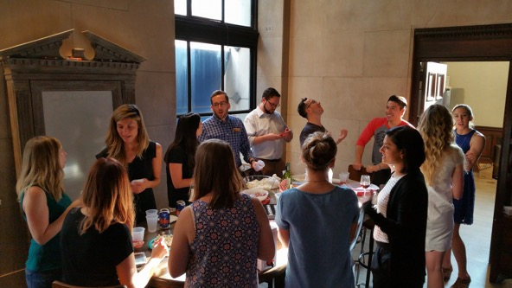
P: Personal
There’s a person watching your video: Talk to them
Draw them in through the screen
Invite discussion, unite people around your videos

Slide 84
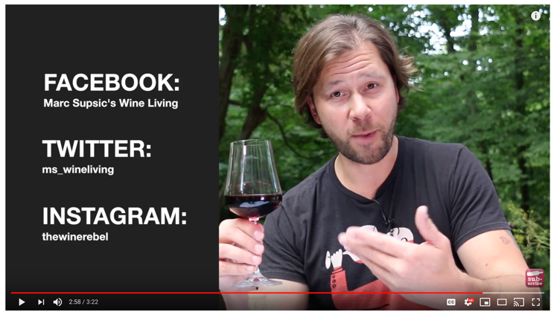
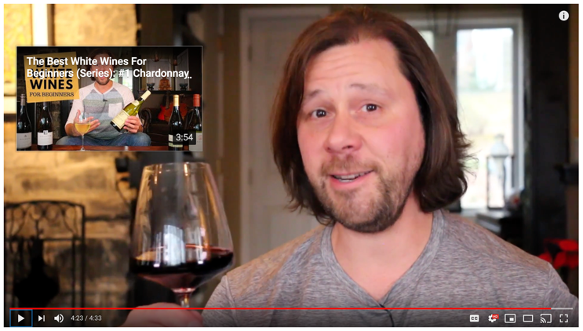
E: Engage
The video is just the
beginning of the discussion
Follow up and follow through
Invite them in deeper –
link to other vids, SM, etc.

Slide 85



Engaged
audience
“Best Red Wines for Beginners,” Series
24K views
269 likes
7 dislikes?

Slide 86



Engaged
audience
“A Wine Expert Tastes Mad Dog”
12K views
82 likes
12 dislikes?

Slide 87



Very engaged
audience
“Tales From the Cabinet”
8K views

Slide 88

G: Have a Goal
R: Be Real
A: Offer an Adventure
A: Give Answers and solutions
P: It’s Personal
E: Engage your audience
S: Make people feel Special.
GRAAPES
(I tried…)

Slide 89
ENERGY BREAK

Slide 90
You Decide!
A Round-Robin Event
All Attendees

Slide 91
Paper & Postage:
A Journey to Price Increases

Slide 92

PRIZM Approach to Renewals

Slide 93
Acquisition Suppression Files

Slide 94
Estimated average merge retention rate across Co-op/MSB stations: 55%

Slide 95
ENERGY BREAK

Slide 96
Ride the Tide
Tim Oleary, NextGen CEO

Slide 97
THANK YOU
&
SAFE TRAVELS

